Slide 1
PRD Genie
Applied Agentic AI for PMs/TPMs, capstone project
An AI pipeline that turns meeting notes into PRDs and user stories, without inventing requirements
Naveen M R
7 November 2026
Notes:
About 20 seconds. Hello, I’m [presenter name]. This is PRD Genie, my capstone project for Applied Agentic AI. It is an AI pipeline that turns meeting notes and transcripts into PRDs, epics and user stories, with one rule above all others: it must not invent requirements.

Slide 2

Turning meetings into documents is slow, uneven and risky
Rewriting
Inconsistent formats
Lost requirements
Transcripts and notes are turned into structured documents by hand.
Every PM structures a PRD differently, so engineering must decode each one.
What was said in the meeting does not always reach the PRD.
The biggest risk: an AI that invents a requirement nobody stated
PRD Genie
2 / 10
Notes:
About 30 seconds. PMs at NeuronForge turn meeting discussions into PRDs by hand, and three things hurt. Transcripts get rewritten into structured documents. Every PM uses a different format, so engineering has to decode each one. And requirements said in the meeting get lost before they reach the document. An AI could help, but the risk is obvious: if it invents a requirement nobody stated, engineering builds the wrong thing. So the design goal is not only speed. It is traceability.

Slide 3


Three stages, with the PM approving each one
Analyze
PRD
Stories
Extracts only what was said, with exact quotes, and asks about what is missing.
Fills a fixed 10-section template, using only the approved extraction.
Writes epics, features and stories that trace back to the PRD.
The PM reviews and approves each result before the next stage runs.
PRD Genie
3 / 10
Notes:
About 30 seconds. The pipeline has three stages. Analyze extracts what was said, with exact quotes, and asks questions about what is missing. PRD turns the approved extraction into a fixed ten-section template. Stories breaks the approved PRD into epics, features and stories. The PM approves each result before the next stage runs. That is the human-in-the-loop part of the design. Stories come from the approved PRD, not from an AI draft, and a long transcript is read only once, which keeps cost down.

Slide 4
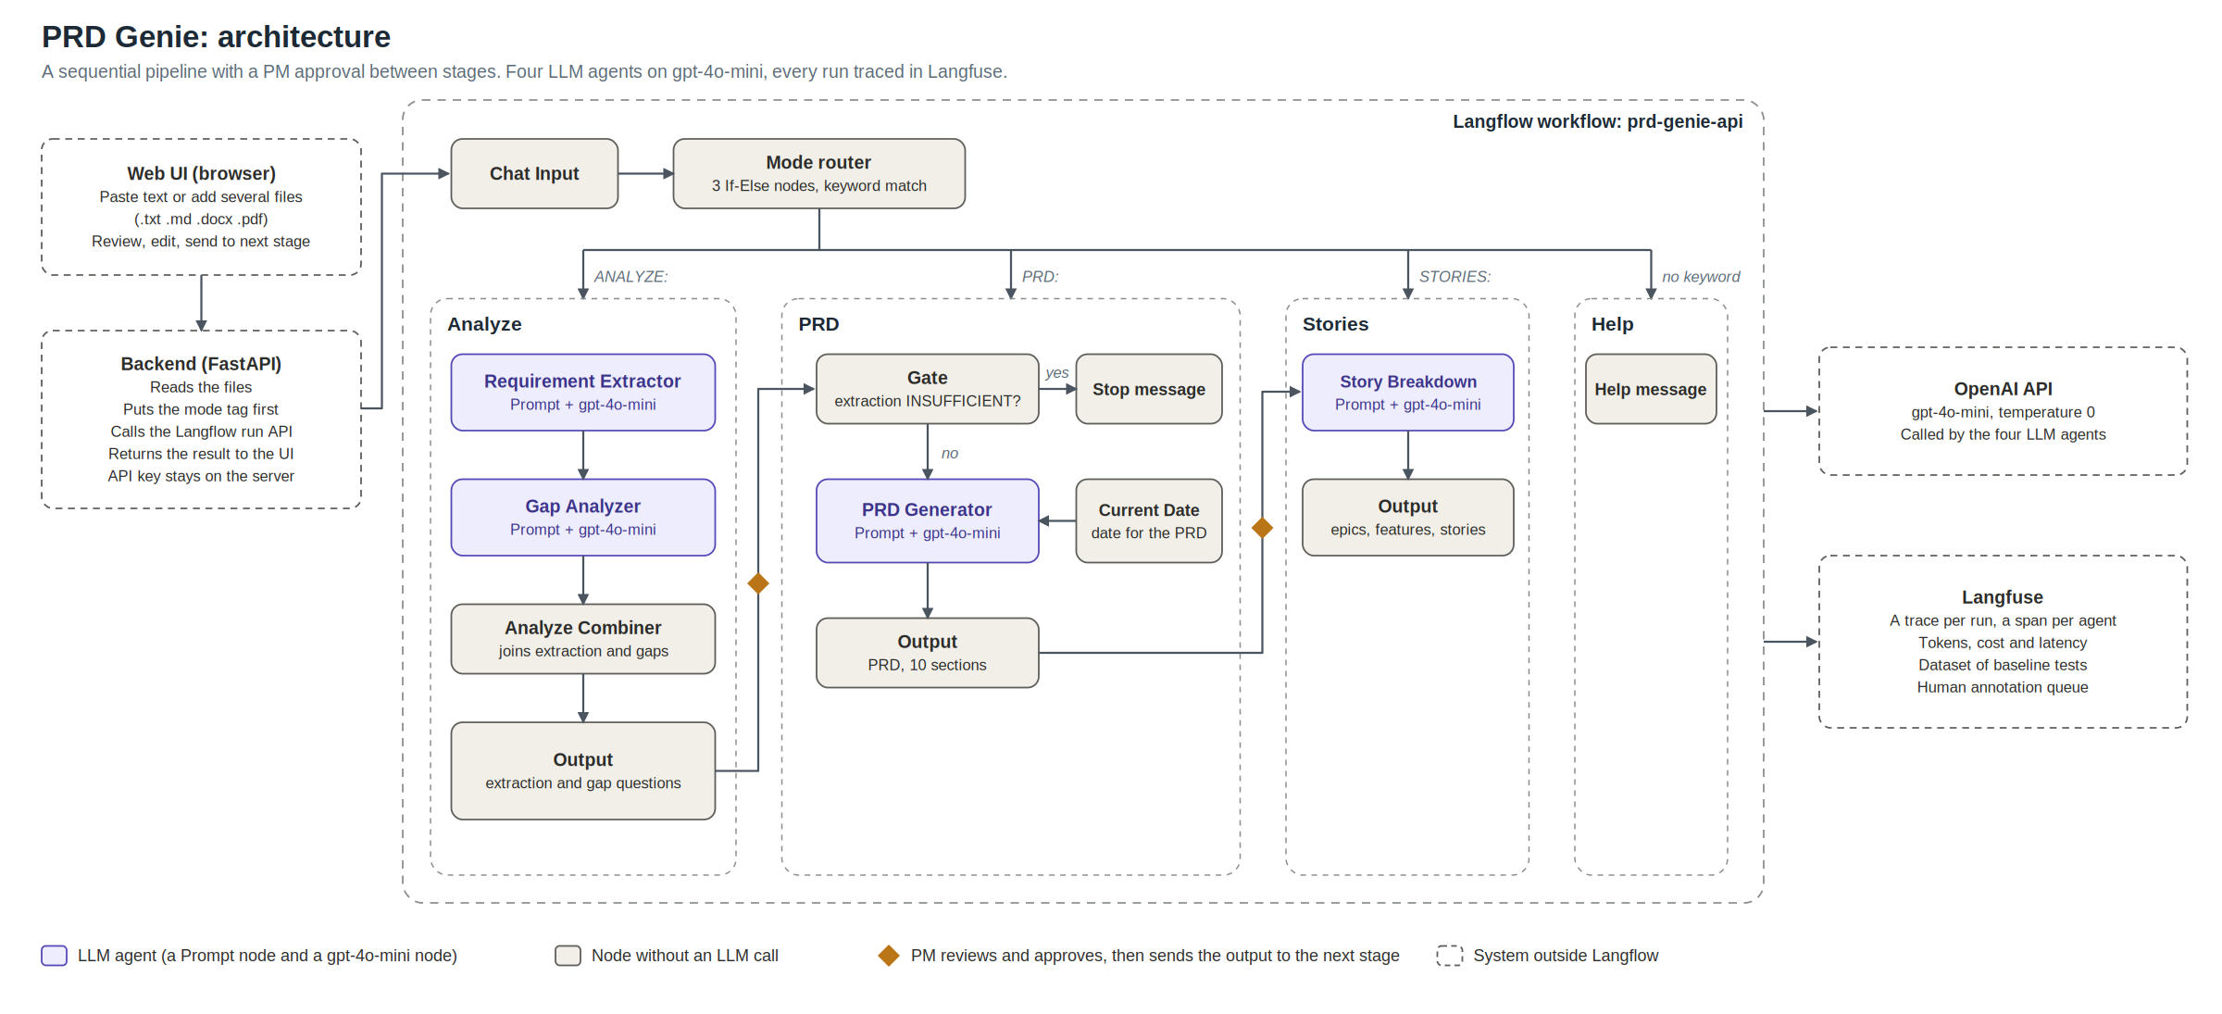
How it fits together
Four LLM agents on gpt-4o-mini, every run traced in Langfuse
4 / 10
Notes:
About 30 seconds. A small web UI takes pasted text or several files and sends them to a backend, which adds a mode keyword and calls Langflow. A router matches the keyword with plain text rules, not an LLM, so it costs nothing and cannot misroute. Four agents run on gpt-4o-mini: the requirement extractor, a gap analyzer, the PRD generator and the story breakdown. A deterministic gate stops the PRD stage when the extraction is marked insufficient. Every run is traced in Langfuse. The full diagram is in the repository, so I will not read it box by box.

Slide 5
Live demo
1
Vague notes are flagged, not filled in
The agent asks for users, metrics and the output format
2
Detailed requirements run through all three stages
One chain, with the PM approving between stages
3
An empty input is stopped by the gate
No PRD is built from nothing
Then the Langfuse trace: tokens, cost and latency for each agent
PRD Genie
6 / 10
Notes:
About 90 seconds. Switch to the UI at http://127.0.0.1:8000, and run each input once before the recording so you know what to expect. Each run takes 10 to 20 seconds, so talk while it runs. Step 1, Analyze with this text: We need better reporting. Something like what Competitor X has. Show that the extraction is marked insufficient, that no requirement was invented, and that the gap questions ask about users, metrics and output format. Step 2, Analyze with this text: The user should be able to filter reports by date range, category, and status. Results must load in under 2 seconds. PM: Sarah. Deadline: Q3. Then click Send extraction to PRD and Generate PRD, then Send PRD to Stories and Write stories. Point out the exact quotes, the persona, the placeholder benefit and the priority marked as a suggestion. Step 3, Analyze with this text: Meeting happened. Notes: none. Click Send extraction to PRD and Generate PRD. Only the stop message appears. Finish in Langfuse: open one trace and show a span per agent with tokens, cost and latency.

Slide 6
Results on the baseline set
11 of 12
17
1 of 17
tests meet their criteria
stage runs recorded, with every output
runs with a small unsupported detail
What worked
What failed
Vague input flagged (T2, T5, T9). Exact numbers kept (T7). An explicit conflict found (T6). Criteria copied verbatim (T4).
T3: an implicit trade-off between two statements is not detected, though explicit disagreements are.
PRD Genie
7 / 10
Notes:
About 30 seconds. I ran the 12 baseline inputs as 17 stage runs, and recorded every output. Eleven of the twelve tests meet their criteria. The one that fails is T3, where two statements pull against each other without anyone disagreeing out loud. One of the seventeen runs contained a small unsupported detail: a role expanded from PM to Product Manager. What worked: vague input was flagged and not filled in, exact numbers survived, an explicit conflict was found, and acceptance criteria were copied verbatim. I also scored nine traces by hand in Langfuse. Faithfulness averaged 4.9 out of 5 and completeness 4.7, but usefulness only 3.3: the agents rarely invent, but they sometimes fail to flag or capture something. If you adjust the tracker’s counts before presenting, change the three numbers on the slide to match.

Slide 7
Every item must trace back to the source
Exact quotes
No guessing
Every requirement carries the words that were said.
Missing fields read “Not specified in source”.
A gate
Labelled drafts
An extraction marked INSUFFICIENT never becomes a PRD.
Priority and benefits come from the source, or stay a visible placeholder.
PRD Genie
5 / 10
Notes:
About 30 seconds. Four rules keep the agents honest. Every requirement carries an exact quote. Anything missing reads “Not specified in source”. An extraction marked insufficient never becomes a PRD. And priorities and benefits come from the source, or stay a visible placeholder. In my tests, the first prompts broke each of these rules, and every fix became a rule in the prompt. I will show you the result next.

Slide 8
Each failure became a rule, then a re-test
Failure found | Fix | Result after the re-test
The stories invented defaults and message texts | A stricter prompt: criteria in quotes, no drafted rules | T4, T8 and T12 pass with no invented specifics
An empty input gave no useful question (T9) | A rule: INSUFFICIENT must name what is missing | The Gap agent now asks for it
An invented risk, priority and deadline | A rule: copy only words that appear in the input | Gone in the final runs
Stories invented benefits and priorities | A placeholder benefit; priority only from the PRD | No invented benefits
One passing run is not proof, so the baseline set is re-run after every prompt change
8 / 10
Notes:
About 40 seconds. The evaluation loop mattered more than the first version. The first Stories prompt invented defaults and message texts. A stricter prompt fixed that, and three tests now pass with nothing invented. An empty input first returned nothing useful, and a rule that insufficient must name what is missing fixed it. Each failure became a rule, then a re-test against the same inputs. The lesson is that one passing run is not proof, because output varies between runs even at temperature zero. So the baseline set is re-run after every prompt change.

Slide 9
A full run costs about $0.002
$0.0022
36 s
$0.17
for one chain: Analyze, PRD and Stories
from notes to stories
per PM per month, at 3 documents a day (an assumption)
Stories is 55% of the cost and 53% of the time.
Output tokens are 25% of the tokens but 58% of the cost.
Measured in Langfuse on one chain; the monthly figure uses an assumed rate
9 / 10
Notes:
About 30 seconds. These numbers come from the Langfuse traces. A full chain costs about two-tenths of a cent and takes 36 seconds. At three documents a day, which is an assumption, that is about seventeen cents per PM per month. Stories is the biggest cost, and output tokens are a quarter of the tokens but 58% of the cost, so the lever is making agents write less. Money is not the constraint here. The real value is PM time saved, which the traces cannot show, so a pilot is the next step.

Slide 10
Known limits and what comes next
Known limits
Next
An implicit trade-off is missed (T3)
Output varies between runs
Stories are thin by design
A questions-first step: the PM answers before stories are written
Ask which one is meant (which API, which competitor)
A pilot with 3 to 5 PMs to measure time saved
Code, prompts, results and documents: [GitHub link]
PRD Genie
10 / 10
Notes:
About 30 seconds. The limits are honest ones. Implicit conflicts are missed, output varies between runs, and the stories are thin because the agent does not draft business rules on its own. The plan: a questions-first step where the PM answers decisions before stories are written, a rule so the Gap agent asks which one is meant when the input names something without identifying it, and a pilot with three to five PMs to measure the time saved. Everything is in the repository. Thank you, and I am happy to take questions.

